Slide 1


PI-STORAGE: A COST-EFFECTIVE AND SECURE RASPBERRY PI-BASED NAS SOLUTION
Bangalore Institute of Technology
K.R. Road, V V Puram, Bangalore-560004
Department of Electronics and Communication Engineering
MAJOR-PROJECT-22EC76 PRESENTATION
Under the guidance of:
Presented by
Likhitha K
Assistant Professor
Dept. of ECE
BIT.
Abhishek Agarwal 1BI22EC003
Aditya S Gowda 1BI22EC007
Aditya Umesh 1BI22EC008
Amruth Shirin K H 1BI22EC012

Slide 2
CONTENTS
CONTENTS
INTRODUCTION
PROBLEM STATEMENT
LITERATURE SURVEY
METHODOLOGY
CONCLUSION
REFERENCES
Bangalore Institute of Technology
Dept. of ECE, BIT

Slide 3
INTRODUCTION
Pi-Storage is a cost-effective, secure, and energy-efficient Network Attached Storage (NAS) solution built using a Raspberry Pi. Designed for personal users and small businesses, it offers centralized file storage and management over LAN and the internet. By leveraging open-source tools and standard protocols, Pi-Storage ensures flexibility, scalability, and platform compatibility.
Key Benefits:
Low Power Usage – Ideal for 24/7 operation
Affordable – Much cheaper than commercial NAS systems
Secure – SSH, VPN, TLS/SSL, and firewall integration
Redundant Storage – RAID support using mdadm
Cloud Sync – Real-time backup via Next cloud/OwnCloud
Cross-Platform Access – Works on Windows, Linux, macOS
Modular Expansion – Supports Docker, Plex, Jellyfin
Bangalore Institute of Technology
Dept. of ECE, BIT

Slide 4
PROBLEM STATEMENT
Problem Statement: High-cost, power-intensive NAS solutions are inaccessible to individuals and small businesses. There is a need for a secure, energy-efficient, and affordable storage system that offers remote and local access.
Scope:
Build a low-cost NAS using Raspberry Pi
Support SMB, NFS, SFTP for cross-platform file sharing
Enable RAID via mdadm for redundancy
Add cloud sync (Nextcloud/OwnCloud), media streaming (Plex/Jellyfin)
Include web-based management (OpenMediaVault)
3. Limitations:
Limited performance due to Raspberry Pi hardware
Not suitable for enterprise-scale storage or high concurrency
Software RAID only (no hardware RAID support)
Requires technical setup for VPN and remote access
Limited number of external drives supported
Bangalore Institute of Technology
Dept. of ECE, BIT

Slide 5
LITERATURE SURVEY
SL.NO | TITLE | AUTHORS | YEAR | DESCRIPTION
1 | DIY Raspberry Pi NAS | Smith et al. | 2020 | Provided the basic hardware setup and architecture for building a NAS using Raspberry Pi.
2 | Low-Cost NAS using RPi | A. Kumar et al. | 2021 | Informed the selection of cost-effective components and power-efficient design choices.
3 | Software RAID with mdadm on Linux | K. Raj et al. | 2021 | Guided the implementation of RAID 1 using mdadm for redundancy and data protection.
4 | Cloud Sync with OwnCloud on RPi | Jane Doe et al. | 2022 | Guided the implementation of RAID 1 using mdadm for redundancy and data protection.
5 | OpenMediaVault Performance on RPi | L. Zhang et al. | 2023 | Evaluated OpenMediaVault performance to select an optimal NAS management platform.
Bangalore Institute of Technology
Dept. of ECE, BIT

Slide 6
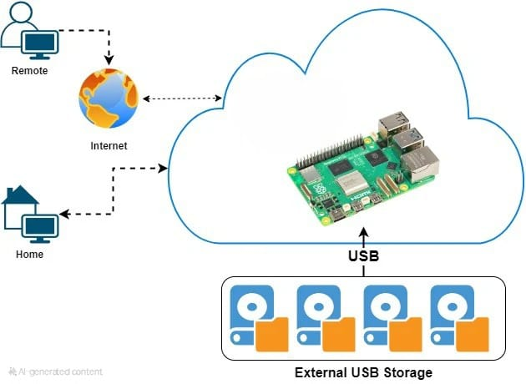
CIRCUIT DIAGRAM
BLOCK DIAGRAM:
Bangalore Institute of Technology
Dept. of ECE, BIT

Slide 7
METHODOLOGY
1.Hardware Setup:
Connect Raspberry Pi 4/5 with external HDD/SSD via SATA-to-USB adapter.
Ensure proper power supply for external drives.
2.Operating System Installation:
Install Raspberry Pi OS (Lite/Desktop) or Debian-based OS.
Update packages and configure SSH for remote access.
3.File Sharing Configuration:
Install and configure Samba (SMB), NFS, and SFTP for LAN access.
Set up user permissions and shared directories.
4.RAID Configuration:
Use mdadm to set up software RAID (e.g., RAID 1 for redundancy).
5.Cloud Sync Integration:
Deploy Nextcloud or OwnCloud for real-time backup & remote access.
6.Security Implementation:
Enable SSH, TLS/SSL encryption, and VPN (WireGuard/OpenVPN).
Set up firewall rules using UFW/IPTables.
7.Web Interface & Expansion:
Install OpenMediaVault for browser-based management.
Use Docker for deploying Plex/Jellyfin and other services.
Bangalore Institute of Technology
Dept. of ECE, BIT

Slide 8
HARDWARE AND SOFTWARE REQUIREMENTS
HARDWARE | SOFTWARE REQUIREMENTS
Raspberry Pi 4 / 5: Compact and energy-efficient computing platform. External HDD/SDD: Storage media for NAS functionality. SATA-to-USB 3.0 Adapter: Connects storage device to Raspberry Pi. MicroSD Card (32GB or higher):For OS installation and boot. Power Supply (3A USB-C): Required to power Raspberry Pi and peripherals. Ethernet Cable / Wi-Fi Adapter: Network connectivity (LAN/Internet). | OS: Raspberry Pi OS / Debian Linux. NAS Management: OpenMediaVault. File Sharing: Samba (SMB), NFS, SFTP, FTP. Storage Tools: mdadm, rsync, cron. Cloud Sync: Nextcloud, OwnCloud. Security: WireGuard, OpenVPN, UFW, IPTables. Expansion & Media: Docker, Plex, Jellyfin.
Bangalore Institute of Technology
Dept. of ECE, BIT

Slide 9
CONCLUSION
The Pi-Storage project successfully demonstrates a cost-effective and secure NAS solution using Raspberry Pi. It provides centralized storage with cross-platform file sharing, RAID-based redundancy, remote access via VPN, and cloud synchronization using open-source tools. With features like web-based administration and media streaming, it is well-suited for individuals, small businesses, and educational environments seeking an energy-efficient and scalable storage system.
Limitations & Future Work
Raspberry Pi hardware limits performance, making it less suitable for high-concurrency or enterprise-scale use.
Only software-based RAID is supported future versions could explore hardware RAID or clustering for better reliability.
Requires manual setup and technical knowledge, a simplified web/mobile interface could improve usability.
Limited number of external drives; scalability could be enhanced using Raspberry Pi clustering or SATA expansions.
Security depends on proper configuration future work may include blockchain integration and automated security monitoring.
Bangalore Institute of Technology
Dept. of ECE, BIT

Slide 10
REFERENCES
[1] Smith et al., “DIY Raspberry Pi NAS,” 2020.
[2] A. Kumar et al., “Low-Cost NAS using RPi,” 2021.
[3] K. Raj et al., “Software RAID with mdadm on Linux,” 2023.
[4] Jane Doe et al., “Cloud Sync with OwnCloud on RPi,” 2022.
[5] L. Zhang et al., “OpenMediaVault Performance on RPi,” 2021.
Bangalore Institute of Technology
Dept. of ECE, BIT

